Slide 1
Bulls and Cows Game with Entropy Calculation
Name - Suriya Narayanan Rajavel
Class - Mathematical Foundations for
Data Science
UFID - 96946409

Slide 2
Table of Contents
3
Introduction
20
Code Highlights - Entropy Calculation
5
Theoretical Background
6
What is Entropy
24
Challenges
11
Project Design and Approach
25
Conclusion
15
Code Highlights - Game Implementation

Slide 3
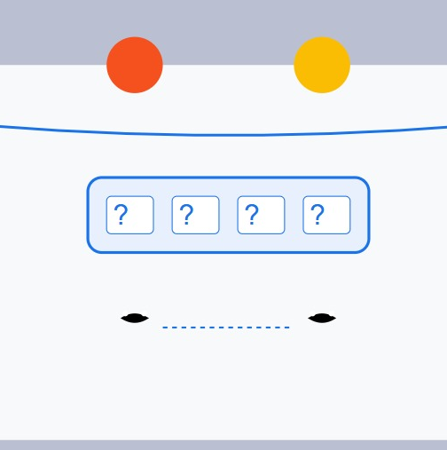
Memory Lane of the Bulls and Cows?
A classic code-breaking game with roots tracing back to the early 19th century, popularized as "Mastermind" in the 1970s.
Players decode a secret 4-digit number with minimal guesses, using feedback on "Bulls" (correct digits in correct positions) and "Cows" (correct digits in incorrect positions).
Beyond fun, this game is a real-world analogy for optimization problems in search algorithms, cryptography, and decision-making.

Slide 5
Theoretical Background
Understanding uncertainty in decision-making and how it can be quantified.
Importance of measuring the information gained from each guess in narrowing possibilities.
How to calculate uncertainty reduction (entropy) and relate it to improved guesses.
How entropy evolves as guesses refine the search.
Leveraging mutual information to optimize the strategy for the next best guess.

Slide 6
What is Entropy?
Entropy helps us understand how uncertain or random a situation is.
Higher entropy means more unpredictability, while lower entropy means more certainty.
Entropy depends on the probability of different outcomes. The more evenly distributed the chances, the higher the entropy.
Helps in understanding and optimizing processes where decisions need to be made, like compressing data or predicting outcomes.

Slide 7
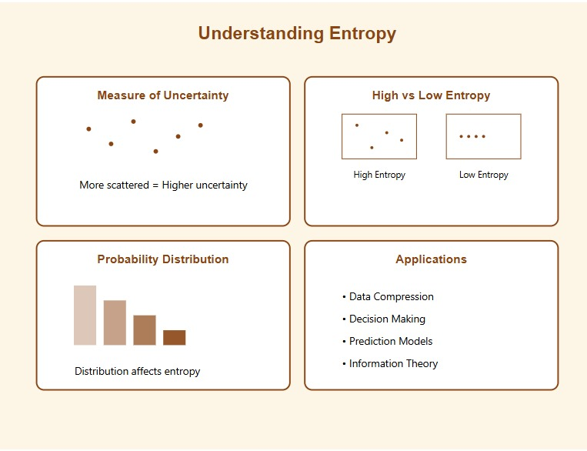
What is Entropy?

Slide 8
What is Entropy?

Slide 9
How Entropy is linked with Bulls and Cows
Understanding the Game's Uncertainty: At the start of the game, all possible codes are equally likely, meaning the uncertainty (or entropy) is at its highest.
Narrowing Down Choices: With each guess, the feedback (bulls and cows) reduces the number of possible codes, lowering the uncertainty.
Guiding Better Guesses: Entropy helps identify which guesses will provide the most information, leading to quicker solutions.
Tracking Progress: As the game progresses and the remaining possibilities shrink, entropy decreases, showing that you're closer to the solution.
A Strategic Edge: Thinking in terms of entropy transforms the game from random guessing to a methodical search for the right code.

Slide 10
How Entropy is linked with Bulls and Cows

Slide 11
Project Design and Approach - Computer Guessing Code
Goal: Enable the computer to guess the player's secret number efficiently using entropy as a guiding metric.
Approach:
Generate All Possible Codes: Start with all 4-digit combinations with unique digits.
Entropy-Based Guessing: Use entropy to select the guess that maximizes information gain from feedback.
Feedback Interpretation: Compute bulls and cows for each guess based on the player's response.
Filter Possible Codes: Narrow down the remaining options using the feedback.
Iterate Until Solution: Repeat the process until the correct number is identified.
Optimization:
Evaluate all potential guesses, even those outside the remaining possibilities, for maximum entropy.

Slide 12
Project Design and Approach - Computer Guessing Code

Slide 13
Project Design and Approach - User Guessing Code
Goal: Help the user guess the computer's secret number with guidance on entropy and feedback.
Approach:
Computer Generates Secret Code: Select a random 4-digit number with unique digits.
User Guesses: Accept user input as a guess and validate it.
Provide Feedback: Compute bulls and cows for the guess to inform the user about their progress.
Calculate Entropy: Display updated entropy to reflect the uncertainty remaining after each guess.
Iterate Until Solved: Allow the user to refine their guesses based on feedback until they find the correct code.
User Experience:
Dynamic feedback and entropy visualization enhance user strategy and engagement.

Slide 14
Project Design and Approach - User Guessing Code

Slide 15
Code Highlights - Game Implementation-Computer Guessing
Key Functions:
compute_feedback(secret, guess): Calculates bulls (correct digit and position) and cows (correct digit, wrong position) for a guess.
filter_codes(possible_codes, guess, bulls, cows): Filters the list of possible codes based on feedback from the previous guess.
calculate_entropy(possible_codes, guess): Computes the entropy for a guess by analyzing feedback probabilities.
find_best_guess(possible_codes, all_codes): Determines the guess with the highest expected information gain.
Core Logic:
Generate all 4-digit unique codes using permutations.
Calculate entropy for each possible guess and select the one that maximizes information gain.
Filter codes iteratively until only one code remains or feedback indicates the guess is correct.
Efficiency Enhancements:
Precomputing feedback for all possible codes reduces runtime during filtering.
Entropy calculation focuses on feedback distributions to prioritize meaningful guesses.

Slide 16
Code Highlights - Game Implementation-Computer Guessing
Key Functions:
compute_feedback(secret, guess): Calculates bulls (correct digit and position) and cows (correct digit, wrong position) for a guess.
filter_codes(possible_codes, guess, bulls, cows): Filters the list of possible codes based on feedback from the previous guess.
calculate_entropy(possible_codes, guess): Computes the entropy for a guess by analyzing feedback probabilities.
find_best_guess(possible_codes, all_codes): Determines the guess with the highest expected information gain.
Core Logic:
Generate all 4-digit unique codes using permutations.
Calculate entropy for each possible guess and select the one that maximizes information gain.
Filter codes iteratively until only one code remains or feedback indicates the guess is correct.
Efficiency Enhancements:
Precomputing feedback for all possible codes reduces runtime during filtering.
Entropy calculation focuses on feedback distributions to prioritize meaningful guesses.

Slide 17
Code Highlights - Game Implementation-Computer Guessing

Slide 18
Code Highlights - Game Implementation-User Guessing
Key Functions:
compute_feedback(secret, guess): Same as in the computer guessing problem, evaluates bulls and cows for user-provided guesses.
is_valid_guess(guess): Ensures the user’s guess is a valid 4-digit number with unique digits.
calculate_current_entropy(bulls, cows): Computes the current entropy based on feedback to show the remaining uncertainty.
Core Logic:
Generate a random secret code for the computer.
Accept user input, validate the guess, and compute feedback.
Calculate entropy dynamically and display it to guide the user’s next guess.
User Experience Features:
Clear feedback on each guess to encourage strategic thinking.
Dynamic entropy updates provide real-time insights into progress.

Slide 19
Code Highlights - Game Implementation-User Guessing

Slide 20
Code Highlights - Entropy Calculation -Computer Guessing
Approach:
Feedback Distribution: Compute the distribution of possible feedbacks (bulls and cows) for a given guess across all remaining codes.
Entropy Formula: Use the formula: H(X)=−∑P(x)log⁡2(P(x))H(X)
where P(x)P(x)P(x) is the probability of each feedback.
Expected Information Gain: The higher the entropy, the more uncertainty the guess is expected to reduce.
Key Function: calculate_entropy
Iterates over all possible codes.
Tracks feedback counts to determine probabilities.
Returns the total entropy for the given guess.

Slide 21
Code Highlights - Entropy Calculation -Computer Guessing

Slide 22
Code Highlights - Entropy Calculation - User Guessing
Simplified Calculation:
Base entropy is set to 4×log⁡2(10)4 , representing the maximum uncertainty for 4-digit numbers.
Remaining uncertainty is reduced based on feedback: Remaining Uncertainty=1.0−(Bulls4+Cows8)
Remaining Uncertainty=1.0−(4Bulls​+8Cows​)
Current Entropy=Base Entropy×Remaining
Current Entropy=Base Entropy×Remaining Uncertainty
Displays entropy dynamically after each guess to guide the player.
Key Function: calculate_current_entropy
Uses bulls and cows feedback to compute a simplified entropy value.

Slide 23
Code Highlights - Entropy Calculation - User Guessing

Slide 24
Challenges
Computing entropy for every possible guess across all remaining codes is computationally expensive, especially as the solution space is large initially.
Handling incorrect or inconsistent feedback from the user, which can disrupt the entropy calculation and filtering process.
Ensuring bulls and cows feedback is clear and consistent for the user to make informed guesses.

Slide 25
Conclusion
Implemented the Bulls and Cows game with enhanced decision-making through entropy and mutual information.
Designed two modes:
Computer Guessing: Optimized guesses using entropy to maximize information gain.
User Guessing: Guided users with feedback and real-time entropy updates.
Demonstrated how concepts like entropy can transform random guessing into a strategic process.
"Entropy doesn’t just reduce uncertainty; it empowers smarter decisions, whether in games or the real world."

